Slide 1
Economics & Management
Lecture 10
Dua Agha
Lecturer
Dept. of Software Engineering

Slide 2
Cost-Benefit Analysis & Break-Even Analysis

Slide 3
Cost-Benefit Analysis
Cost denotes the amount of money that a company spends on the creation or production of goods or services.
Cost-Benefit Analysis (CBA) is a systematic process used to evaluate the financial and social costs and benefits of a project or decision.
Simply, is a method to compare the costs and benefits of a decision (ROI & Payback Period).
The goal is to determine whether the benefits outweigh the costs.

Slide 4
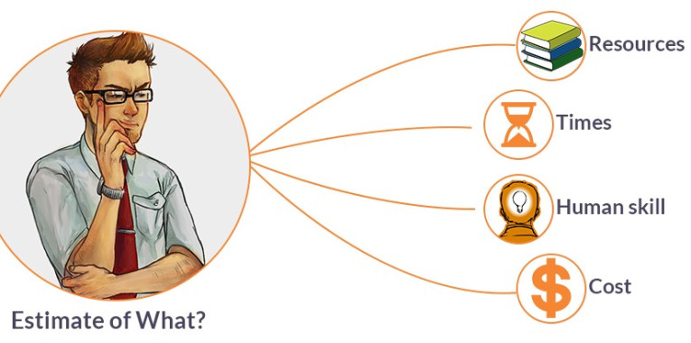
Identify Costs and Benefits
1. Costs:
These can be direct (e.g., money spent on equipment) or indirect (e.g., time lost due to training).
2. Benefits:
These include direct gains (e.g., revenue increase) and indirect gains (e.g., improved customer satisfaction).

Slide 5
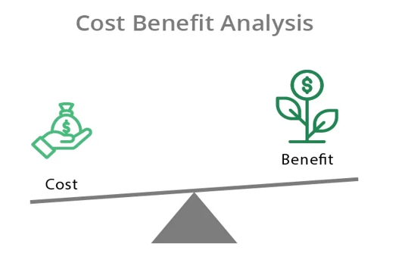

Slide 6

Cost Benefit Analysis is used to determine:
Whether a solution/project is economically feasible
Which of two or more projects provides the best return on investment
Other issues:
Is the project worthwhile financially?

Slide 7
Formula: (Total cost – Total benefit = Net benefit)
If the net benefit is positive then the cost benefit is positive & if the net benefit is negative then the cost benefit is negative.
Example: Imagine you're a software developer considering whether to create a new app.
Costs:
Development time: 6 months
Developer salary: $50,000
Marketing: $10,000
Total cost: $60,000
Benefits:
Expected revenue from app sales: $80,000
Improved company reputation: Difficult to quantify but valuable
Total benefit: $80,000 + intangible benefits
Analysis: If the total benefit ($80,000) is greater than the total cost ($60,000), the project is likely a good investment.

Slide 8
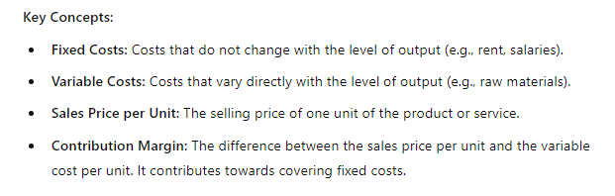
Break-Even Analysis
Break-Even Analysis is a technique used to determine the point at which a business's revenues will exactly cover its costs, resulting in neither profit nor loss. This point is known as the break-even point.

Slide 9
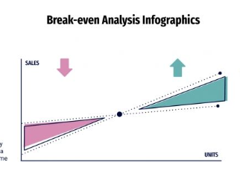

Slide 10
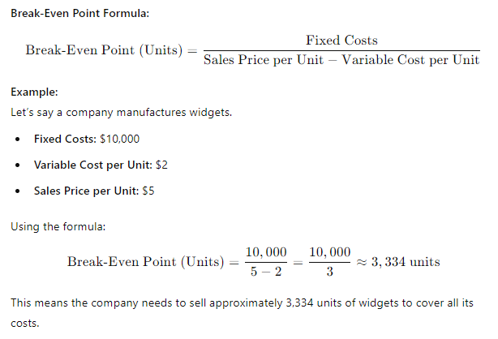

Slide 11
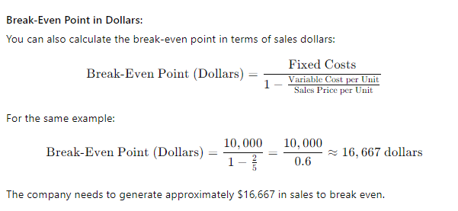

Slide 12
Summary
Cost-Benefit Analysis helps in deciding whether a project or investment is worth pursuing by comparing the costs and benefits.
Break-Even Analysis helps in determining the point where total revenues equal total costs, indicating no profit or loss.
Both analyses are crucial tools in business decision-making.

Slide 13
Problem 1: A company that produces custom-designed T-shirts incurs fixed costs of $20,000. The variable cost per T-shirt is $5, and each T-shirt is sold for $12.
Determine the break-even point in terms of units.
Determine the break-even point in terms of revenue (dollars).
Problem 2:
A bakery that specializes in custom cakes has fixed costs of $25,000. The variable cost per cake is $8, and each cake is sold for $20.
Determine the break-even point in terms of units.
Determine the break-even point in terms of revenue (dollars).

